Slide 1

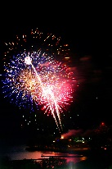
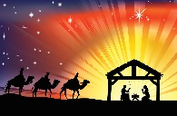
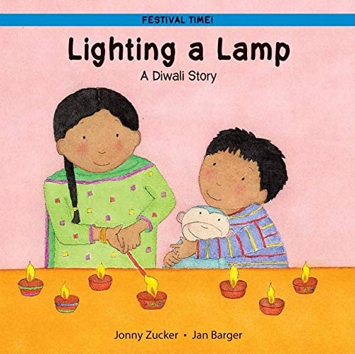
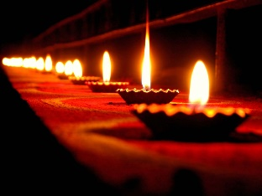

EYFS
Autumn
Manor Leas Infant School Knowledge Organiser
Understanding of the World
People and Communities
Star Words | Definition
Celebration | To do something special or enjoyable for an important occasion or event.
Birthday | The day we celebrate the day someone special was born.
Baptism | The way some Christians celebrate and thank God for the birth of a baby.
Lakshmi | The Hindu goddess of wealth and purity.
Jesus | Christians believe Jesus is the son of God
Sticky Knowledge
Bonfire night is celebrated on the 5th November. It is also sometimes known as firework night or Guy Fawkes night
Christians celebrate Christmas on 25th December. Christmas celebrates the birth of Jesus Christ.
Helpful Books
Home Learning Ideas
Talk about/look at pictures of events you have celebrated as a family
Work together as a family to prepare for a special event
Hindus celebrate Diwali which is known as the “festival of lights”. They share the story of Rama, Sita and the demon king, Ravana.
During Diwali people clean their homes and decorate their doorstep with Rangoli patterns.
Small lamps called Divas are lit to guide Lakshmi to people’s homes so she can bless them.
This year, Diwali will be celebrated on Monday 20th October.
Helpful Websites
What is Diwali? https://www.bbc.co.uk/bitesize/articles/zpvn3qt
What is Christmas? https://www.bbc.co.uk/bitesize/articles/zdjjf4j#zgjmg2p

Slide 2
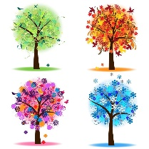


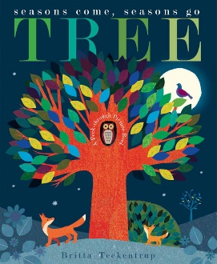

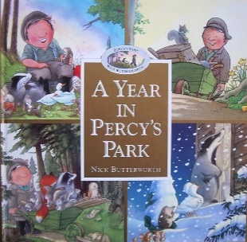



EYFS
All year
Manor Leas Infant School Knowledge Organiser
Understanding of the World
The Natural World - Seasons
Star Words | Definition
Seasons | A time of year with its own kind of weather. There are four seasons.
Seasonal change | How the world becomes different during each season.
Weather | What the air outside is like each day. The air affects our lives and what we wear.
Weather forecast | A prediction of what the weather will be like in an hour, tomorrow or next week.
Temperature | How hot or cold something is.
The four seasons are called, Spring, Summer, Autumn
and Winter. During each season the world around us
changes, we notice this particularly when watching the
Trees grow.
In the Summer, the weather can get warmer and we need to make sure we can stay safe. We must drink lots of water, wear sun
hats and use sun cream. We must also try not to be in the sun
for too long.
In Spring, it starts to get warmer and there are more hours of daylight. Plants start to grow and baby animals are born.
Helpful Books
Home Learning Ideas
Go on a walk and collect seasonal items you find such as conkers or acorns.
Use the things you find to make a picture
Autumn starts in September and ends in November. It gets colder and the days feel shorter because there is less sunlight.
Helpful Websites
BBC bitesize https://www.bbc.co.uk/bitesize/articles/zsb6s82
https://www.bbc.co.uk/bitesize/topics/zhwq6rd
In Winter it gets colder and the hours of daylight get shorter. It might rain or snow more. I must wear clothes to help keep me warm such as a coat, hat, scarf and gloves.

